Slide 1
Module 3: Individual Peacekeeping Personnel
Lesson
3.4
Sexual Exploitation and Abuse

Slide 2
Relevance
Allegations of sexual exploitation and abuse (SEA) by UN personnel
UN zero tolerance policy on SEA
Obligation of ALL
UN Core Pre-Deployment Training Materials 2017

Slide 3
Learning Outcomes
Learners will:
Explain “zero tolerance of SEA”
Describe SEA and uniform standards on SEA
Describe DPKO three-pronged approach
List actions to take to support zero tolerance of SEA
UN Core Pre-Deployment Training Materials 2017

Slide 4
Lesson Overview
Duty to “Protect and Serve”
Zero Tolerance of SEA
Definition of SEA
Uniform Standards on SEA – Prohibited Acts
DPKO’s Three-Pronged Approach to SEA
What Individual Peacekeeping Personnel Can Do
UN Core Pre-Deployment Training Materials 2017

Slide 5
Learning Activity
3.4.1
Film: To Serve With Pride
Instructions:
How do UN personnel “abuse” power and trust?
What are the consequences of sexual exploitation and abuse for victims?
How does it affect the image of the UN?
What does “zero tolerance” mean?
Time: 30 minutes
Film: 24:24 minutes
Discussion: 5 minutes
https://www.youtube.com/watch?v=NfMKMCYFgPo
UN Core Pre-Deployment Training Materials 2017

Slide 6
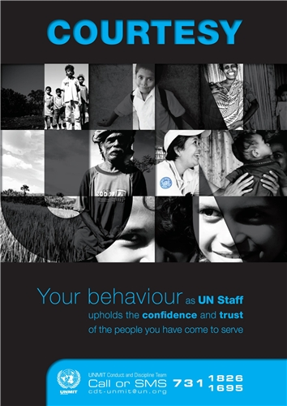
1. Duty to “Protect and Serve”
Your conduct as UN personnel must uphold the confidence and trust of people you serve
UN Core Pre-Deployment Training Materials 2017

Slide 7
2. Zero Tolerance of SEA
Impunity and complacency not tolerated
Active measures to prevent SEA
Action against ALL violators
UN Core Pre-Deployment Training Materials 2017

Slide 8
3. Definition of SEA
Sexual exploitation: actual or attempted abuse of a person’s vulnerability, differential power or trust for sexual purposes, including profiting monetarily, socially or politically from the exploitation
Sexual abuse: actual or threatened physical intrusion of a sexual nature, by force or under unequal or coercive conditions
Sexual exploitation and abuse constitute Category I serious misconduct
UN Core Pre-Deployment Training Materials 2017

Slide 9
Interpreting Key Words
Vulnerable | Fighting for survival in desperate circumstances Lack of awareness of rights and obligations, denial of human rights Unequal power relations that can be exploited Prevalence of sexual and gender-based violence
Differential Power | An imbalance between economic, social, education and professional status A dependence by one person on another to sustain life A position of authority of one person over another
Abuse of Trust | Further victimizes vulnerable persons Violates victims’ human rights Disrupts families/communities and undermines peace
Beneficiaries of Assistance | Broadly interpreted to cover the local population the UNPKO is mandated to serve
UN Core Pre-Deployment Training Materials 2017

Slide 10
Difference with Sexual Harassment
Sexual harassment: any unwelcome sexual advance, request for sexual favour, verbal or physical conduct or gesture of a sexual nature or any other behaviour of a sexual nature that might reasonably be expected or be perceived to cause offence or humiliation to another, when such conduct interferes with work, is made a condition of employment or creates an intimidating, hostile or offensive work environment
UN Core Pre-Deployment Training Materials 2017

Slide 11
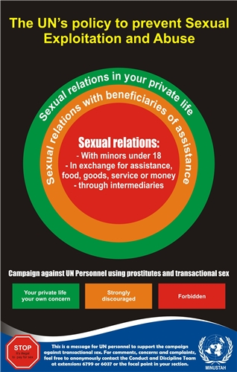
4. Uniform Standards on SEA – Prohibited Acts
Sexual activity with children (persons under the age of 18) is prohibited
Exchange of money, employment, goods, assistance or services for sex, e.g. sex with prostitutes is prohibited
Use of children or adults to procure
sexual services for others is prohibited
Sexual relationships with beneficiaries
of assistance are strongly discouraged
UN Core Pre-Deployment Training Materials 2017

Slide 12
Learning Activity
3.4.2
Guidelines and Prohibitions on SEA
Instructions:
Consider the scenarios
Identify “vulnerability”, “differential power” and “trust”
How have the Uniform Standards on SEA been violated?
Time: 10 minutes
Group work: 5-7 minutes
Discussion: 3 minutes
UN Core Pre-Deployment Training Materials 2017
Notes:
CPTM 3.4.3
Pictures

Slide 13
5. DPKO’s Three-Pronged Approach to SEA
Prevention
Enforcement
Remedial action
UN Core Pre-Deployment Training Materials 2017

Slide 14
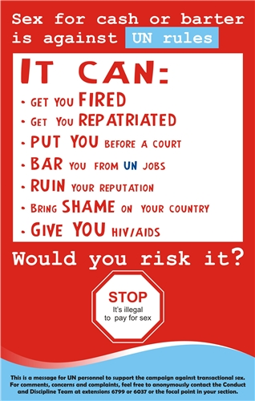
1. Preventive Measures
Uniform standards on SEA
Training
Public information
Welfare and recreation
UN Core Pre-Deployment Training Materials 2017

Slide 15
2. Enforcement Measures
Complaints mechanism/reporting
Data management
Investigations
Follow-up
UN Core Pre-Deployment Training Materials 2017

Slide 16
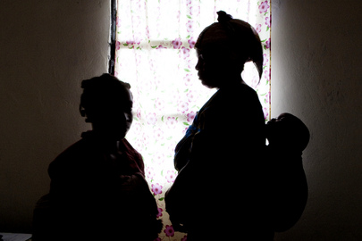
3. Remedial Action
Victim assistance
Reputation repair
Regular briefings
UN Core Pre-Deployment Training Materials 2017

Slide 17
6. What Individual Peacekeeping Personnel Can Do
Individual Responsibility
Professional and personal
Reflect UN image
Uniform standards on SEA
Personal discipline
Duty to SEA-free environment
Duty to report SEA
UN Core Pre-Deployment Training Materials 2017

Slide 18
Leadership and Accountability
Implement policies
Mandatory SEA training by ALL
Focal Points and awareness-raising
Welfare and recreation
Emphasize duty to report
Address violations
Report all misconduct to CDU or OIOS
UN Core Pre-Deployment Training Materials 2017

Slide 19
Summary of Key Messages
“Zero tolerance of SEA” – impunity not tolerated, measures to prevent, disciplinary action
Uniform standards on SEA – no sex with children, prostitutes, and beneficiaries, do not use children or adults to procure sex for others
DPKO three-pronged approach – prevention, enforcement, remedial measures
Take action – your duty, maintain an SEA-free environment, report SEA
UN Core Pre-Deployment Training Materials 2017

Slide 20
Questions
UN Core Pre-Deployment Training Materials 2017

Slide 21
Learning Activity
Learning Evaluation
UN Core Pre-Deployment Training Materials 2017

